Slide 1


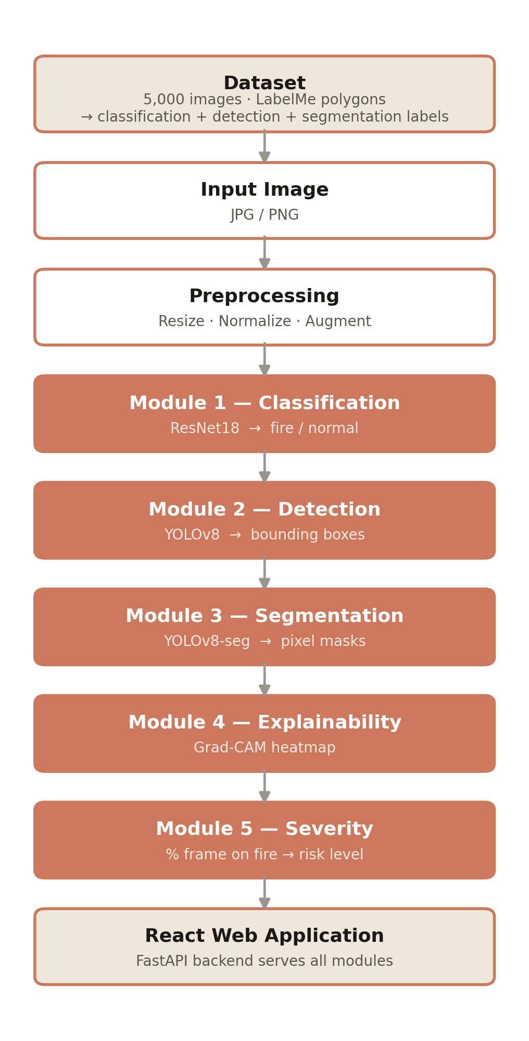
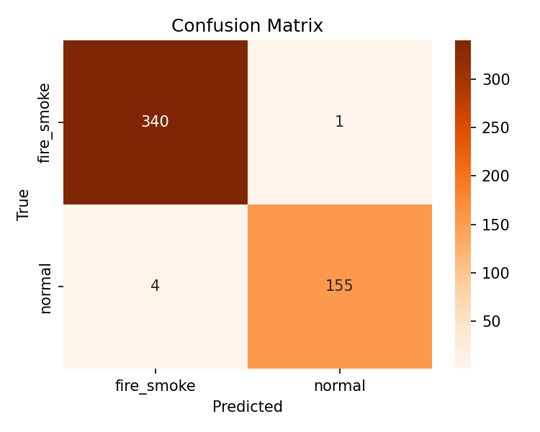
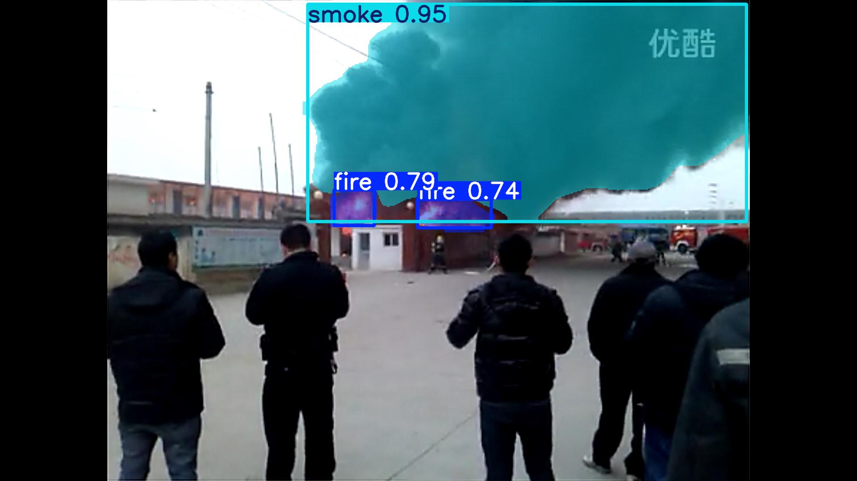
Fire & Smoke Vision Core: A Multi-Module Deep Learning Approach to Fire Detection, Localization & Severity Assessment
Salman Naseem (2023-CS-78) Huzaifa Arshad (2023-CS-86)
Superviser Name : Muhammad Waseem
Department of Computer Science, University of Engineering & Technology, Lahore
Abstract
Related Work
A multi-module computer-vision system that detects fire and smoke in images. It unifies five deep-learning tasks — classification (ResNet18), detection and segmentation (YOLOv8), Grad-CAM explainability and a severity score — trained from one dataset of 5,000 images. On unseen test data it reaches 99.0% accuracy, 0.79 detection mAP and 0.79 mask mAP.
Study | Focus | Strength | Limitation
Muhammad+ 2018 | CNN fire classification | High accuracy | No localization
Li & Zhao 2020 | Faster R-CNN fire | Bounding boxes | Heavy; no masks
Jadon+ 2019 (FireNet) | Lightweight CNN | Real-time | Classify only
Shamsoshoara 2021 (FLAME) | Aerial fire seg. | Pixel masks | Single task
YOLOv8 (Ultralytics) 2023 | General det./seg. | Fast, SOTA | Not fire-specific
This work, 2025 | 5 unified modules + XAI | Explainable, end-to-end | Single-domain data
Introduction
Fire and smoke threaten life and property; early visual detection is vital for surveillance and warning systems. Most solutions only classify 'fire or not' and cannot show where the fire is or how severe it is.
Objectives:
• Add localization, segmentation and risk scoring.
• Train all tasks from one dataset.
• Explain predictions with Grad-CAM.
• Provide an easy web interface.
Methodology
Results
Evaluated on a held-out test set of 500 unseen images. Test scores match or beat validation, so the models generalize without overfitting. Smoke localizes slightly better than fire.
Segmentation + severity result (left) · Classifier confusion matrix (right)
Module | Metric | Score
Classification (ResNet18) | Test accuracy | 99.0%
Detection (YOLOv8) | mAP@50 | 0.787
Segmentation (YOLOv8-seg) | Mask mAP@50 | 0.792
Detection per-class | fire / smoke mAP@50 | 0.75 / 0.80
Severity | Frame coverage | NONE→CRITICAL
Conclusion & Future Directions
One dataset powers five fire-analysis tasks in a single explainable web tool, reaching 99% accuracy and ~0.79 mAP. Future work: higher recall, real-time video, and edge deployment.
References
[1] Redmon et al. YOLO. CVPR 2016.
[2] Jocher et al. Ultralytics YOLOv8. 2023.
[3] He et al. Deep Residual Learning (ResNet). CVPR 2016.
[4] Selvaraju et al. Grad-CAM. ICCV 2017.
[5] Muhammad et al. Fire Detection with CNNs. IEEE Access 2018.

